Slide 1
Digital Transmission Principles
Prof. Cyril Renaud
c.renaud@ucl.ac.uk
Notes:
First shown to be feasible in 1966 by Kao and Hockham.
By 1976 it had become an experimental reality
And by 1986 a major installed transmission technology.
In 1997 research labs first crossed the 1Tb/s in a single fibre, today >6Tb/s systems are in the pipeline.
What has been said about optical fibre.
Effectively Unlimited bandwidth
Near Zero signal attenuation
Near Zero signal distortion
Near zero power requirements
Near zero physical size
Comparatively cheap.
Frequency range > 25Thz possible

Slide 2
Digital Transmission
Binary Transmission as a reference
Additive white Gaussian noise channel
Binary and ternary eye diagrams
Eb/No and System SNR
BER
Multi-level signalling and choice of modulation

Slide 3
Signal types
Random – Deterministic
Discrete Time – Continuous Time
Discrete Amplitude – Continuous Amplitude
Lowpass, Bandpass, Highpass
Periodic or non Periodic
Notes:
Core surrounded by cladding both made primarily of Silica (SiO₂)
Refractive Index of a material is the ratio of the speed of light in a vacuum to the speed of light in that material.
Dopants (Impurities) can be added during manufacture to alter the refractive index.

Slide 4
Discrete-Continuous
Continuous time and amplitude
Discrete time continuous amplitude –PAM signal
Discrete time and amplitude, Multilevel signal.
Notes:
To obtain a simplified understanding of the operation of optical fibres we will use ray theory or geometric optics
Numerical aperture gives the angles of light that will be guided. Usually the difference in refractive index is small, 0.01

Slide 5
Digital line system
Message source
Message sink
Distortion Interference
Noise
Input signal
Output signal
Encoder modulator
Demodulator/ decoder
Communication channel
transmitted signal
received signal

Slide 6
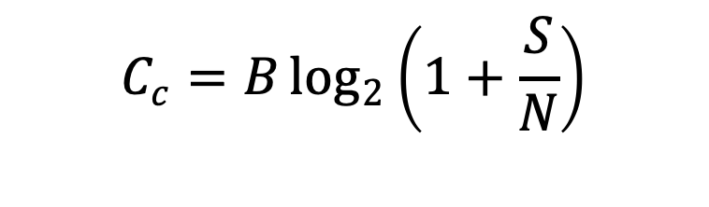
Claude Shannon
Shannon’s Theorem predicts reliable digital communication in the presence of noise
“Given a discrete, memoryless channel with capacity C, and a source with a positive rate R (R<C), there exist a code such that the output of the source can be transmitted over the channel with an arbitrarily small probability of error.”
B is the channel bandwidth in Hz and S/N is the signal to noise ratio
$$C_{c}=B\log_{2}\left(1+\frac{S}{N}\right)$$

Slide 7
For a “good” digital system;
We aim to transmit a “clean” signal and receive an “identical” one
“Identical” means;-
1- no added errors, all 1s received as 1s and all 0s received as 0s; AND
2- Received data has the same timing as transmitted data

Slide 8
Binary transmission system
Noise
Distortion
A
Channel
(fibre/amplifiers
/optical devices)
B
C
Threshold
detector
D
Retiming
circuit
E
Transmitter
Receiver/
Equaliser
F
A: Input data
Clock
extraction
f_{c} = 1/T
B: received waveform
C: Equalized waveform
D: Regenerated waveform
E: Recovered clock signal
F: Retimed data signal

Slide 9
Effects of noise and Distortion
Errors are introduced due to:
Noise on signal
Timing noise and jitter
Inter-Symbol-Interference (ISI)
Errors can be assessed by:
Considering the eye diagram
Measurement of Bit Error Rate (BER) or Pe

Slide 10
Binary signal waveforms
x(t)
Binary data
1
0
1
1
0
1
t
-T/2
0
T/2
T
2T
3T
4T
5T
Filtered binary waveform
1
0
1
1
0
1
t
0
T
2T
3T
4T
5T
p(t)
Element waveform
t
-T
0
T

Slide 11
Eye diagrams
Illustrative signal segments
Decision
threshold
Eye diagram
Sampling
epoch
Overlapped ensemble
of possible waveforms

Slide 12
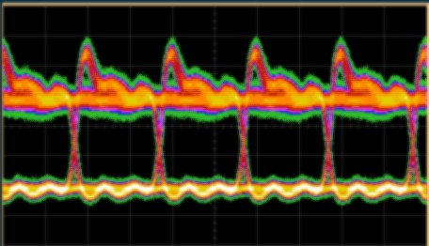
A more realistic eye…
The eye diagram is a powerful diagnostic tool
Noise
Jitter
Telegraph Distortion
ISI
Patterning effects
Bit errors
Normally displayed on a scope at the receiver

Slide 13
Concept of ISI in Binary signals
The signals can be “designed” so as to have no ISI
This is done at the signal shaping/equalisation stage in the receiver
Requires knowledge of received signal shape
(i.e transmitter, channel and receiver behaviour)

Slide 14
A zero isi signal
time domain signal
sin(πt/T)
sinc(t/T) =
πt/T
-2T
-T
0
T
2T
time
corresponding bandlimited spectrum
T rect(fT)
-1/2T
0
1/2T
frequency

Slide 15
Raised cosine family
-2T
-T
0
T
2T
t
50% raised cosine spectrum
100% raised cosine spectrum
-1/T
-1/2T
0
1/2T
1/T
f
Notes:
The raised cosine family of signals are more compact in the time domain and smoother but broader in the frequency domain. This provides both zero isi and zero telegraph distortion. The waveform decays as 1/3t which provides increased tolerance to jitter
For systems in which the additional bandwidth of the 100% raised cosine signal spectrum cannot be accommodated, intermediate solutions exist such as the 50% Raised Cosine.

Slide 16
Eye diagram: 100% raised cosine signal
The 100% raised cosine spectrum corresponds to the minimum bandwidth signal satisfying Nyquist Criteria
This results in signals with zero ISI and zero TD
Zero ISI
Zero TD
Decision point
Threshold
Sampling epoch

Slide 17
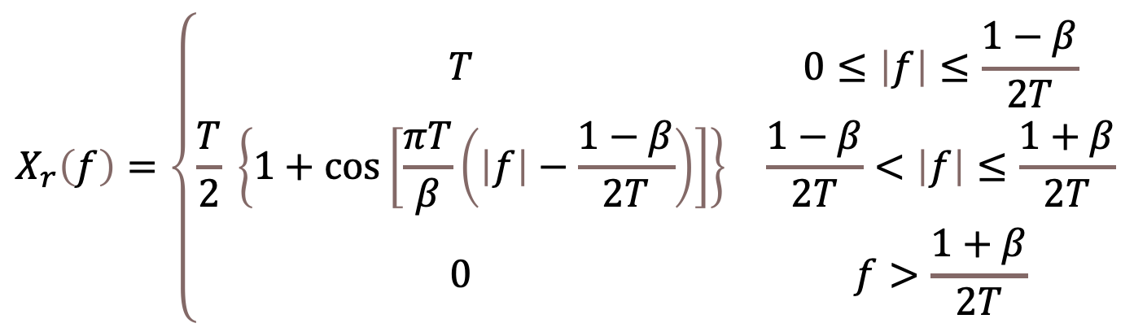
Raised Cosine Spectrum
$$X_{r}\left(f\right)=\left\{\begin{matrix}T & 0≤\left|f\right|≤\frac{1−β}{2T} \\ \frac{T}{2} \left\{1+\cos\left[\frac{πT}{β}\left(\left|f\right|−\frac{1−β}{2T}\right)\right]\right\} & \frac{1−β}{2T}<\left|f\right|≤\frac{1+β}{2T} \\ 0 & f>\frac{1+β}{2T}\end{matrix}\right.$$
Where β is the roll off factor 0< β<1
Excess bandwidth (that above Nyquist) is usually referred to as a percentage of Nyquist
β=1/2 excess Bandwidth = 50%
β=1 excess Bandwidth = 100%

Slide 18
Eye diagram: 1
Zero isi
Zero telegraph distortion
Decision point
Threshold
Sampling epoch

Slide 19
Eye diagram: 2
isi
jitter
Threshold
symbol interval

Slide 20
Signal to Noise Ratio (SNR)
A
Threshold
Sampling epoch
SNR defined in terms of half eye opening and rms noise voltage, σ
SNR=A/σ
Adjusted for multi-level systems for No. levels

Slide 21
Bit error rate (BER)
Distribution of signal + noise when a ‘0’ (-A) is transmitted
Distribution of signal + noise when a ‘1’ (+A) is transmitted
-A
0
+A
Tail area = P[0|1]
Tail area = P[1|0]
Decision
threshold

Slide 22
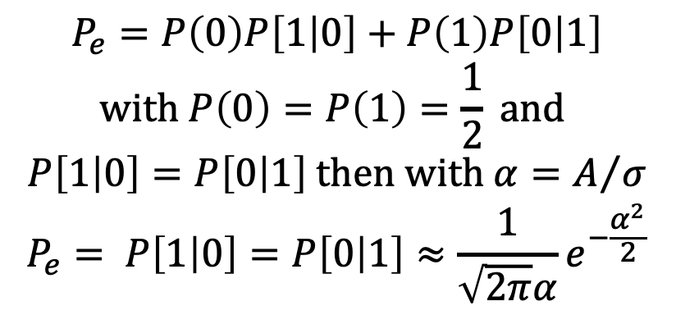
Noise and errors
Probability of error (Pe) or Bit Error Rate (BER) taken as ratio of number of bits received in error to the total number of bits, in a given transmission period.
The primary measure of performance of a digital system
For optical systems BER is < 10⁻⁹,
This can be achieved for SNR value>6
$$P_{e}=P\left(0\right)P\left[1 | 0\right]+P\left(1\right)P\left[0 | 1\right]$$
$$with P\left(0\right)=P\left(1\right)=\frac{1}{2} and$$
$$P\left[1 | 0\right]=P\left[0 | 1\right] then with α=A/σ$$
$$P_{e}= P\left[1 | 0\right]=P\left[0 | 1\right]≈\frac{1}{\sqrt{2π}α}e^{−\frac{α^{2}}{2}}$$
Here α is the SNR and δ is the rms of noise
This applies for Gaussian noise and zero ISI
Distribution of signal + noise when a ‘0’ (-A) is transmitted
Distribution of signal + noise when a ‘1’ (+A) is transmitted
-A
0
+A
Tail area = P[0|1]
Tail area = P[1|0]
Decision
threshold

Slide 23
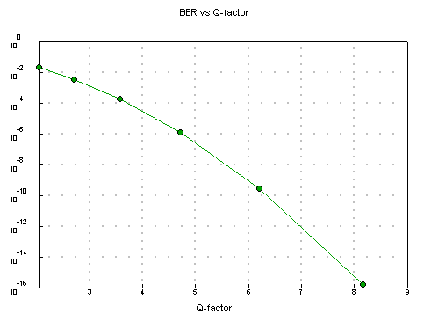
Considerations for designers
1- The error rate deteriorates rapidly with SNR degradation (in the figure SNR is Q-Factor)
2- Noise may be different on the 1s and 0s. Different analysis and design will be needed
Different areas;
P(0|1) ≠ P(1|0)

Slide 24
Q-based system design
The operational system requirement is for a sufficiently low error rate at the end the system - which calls for a sufficiently large Q value at that point
One can analyse a possible system arrangement and determine the signal and noise levels and hence the SNR
From the SNR the corresponding Q can be found which allows the BER to be determined
In design it is often convenient to work from a specified Q to the SNR
Measuring Q can be effected by off-setting the threshold, necessary because systems are designed to operate error-free
BER is measured and plotted versus threshold and then extrapolated to the region of practical interest

Slide 25
Noise on the Signal
Noise on 1s
σ1
Decision
point
p(S+N/1)
P[1/0]
p(S+N/0)
Threshold
P[1/0]
Noise on 0s
σ0
Sampling epoch

Slide 26
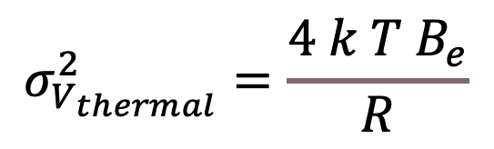
Sources of Noise - 1
Thermal Noise
Due to the random motion of electrons that is always present at a finite temperature
R = Resistance (often 50Ω)
Temperature T
k_{B} = Boltzmann’s Constant = 1.38x10⁻²³ J/ ºK
B_{e}= Electrical Bandwidth
Signal Independent Noise
$$σ_{V_{thermal}}^{2}=\frac{4 k T B_{e}}{R}$$

Slide 27
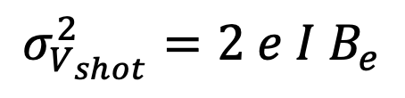
Sources of Noise - 2
Shot Noise
Representation of the random nature of the arrival of photons
e = Charge on an electron = 1.6x10⁻¹⁹ C
B_{e}= Electrical Bandwidth
Î = Average photocurrent generated = ℜP_{rx}/2
ℜ = Responsivity
P_{rx} =Power at the Receiver
Signal Dependent Noise
$$σ_{V_{shot}}^{2}=2 e I B_{e}$$

Slide 28
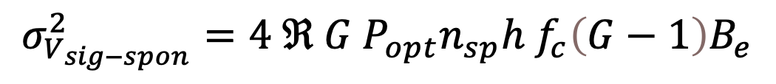
Sources of Noise - 3
Signal Spontaneous Beat Noise
Due to ASE noise from an optical amplifier beating with the signal
G = Amplifier Gain f_{c}= optical frequency
B_{e}= Electrical Bandwidth h =Planck’s Constant = 6.63x10⁻³⁴ J/Hz
P = Power entering amplifier
ℜ = Responsivity
n_{sp} = spontaneous emission factor
Signal Dependent Noise
$$σ_{V_{sig−spon}}^{2}=4 ℜ G P_{opt}n_{sp}h f_{c}\left(G−1\right)B_{e}$$

Slide 29
Signal Dependent Noise
Signal-spontaneous noise is signal dependent
Hence EDFA cascades and optical pre-amplifier based receivers exhibit substantial variation in noise level between 1s (light present) and 0s (light absent), which we then indicate as σ1, σ0
It is appropriate to position the decision threshold somewhat below half way in the eye in order to minimise the total error rate, corresponding to errors occurring approximately equally for 1s and 0s: P[0/1]=P[1/0]

Slide 30
Defining Q: systems without amplifiers
Additive noise, independent of signal level
Bit error rate (BER) corresponds to ‘Gaussian Tail’ or complementary error function, erfc:
BER = erfc(Q) with Q the ratio of signal s to rms noise, i.e. Q=s/σ
Q(dB)=20 log₁₀Q
BER of 10⁻⁹ corresponds to Q=6
System operating margin may be expressed as an electrical Q margin: M_{elec}(dB)=20log₁₀(Q/6)

Slide 31
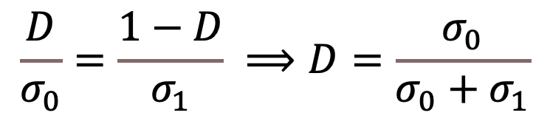
Decision Threshold
The decision threshold is (nominally) set such that P[1/0] = P[0/1]
If noise is equal on 1’s and 0’s then this will be in the middle – signal independent noise
For signal dependent noise With perfect extinction for 0s and normalised decision threshold of this corresponds to equal ‘margins’ for 0s and 1s of D and (1-D) relative to the respective rms noise values σ₀, σ₁, such that:
$$\frac{D}{σ_{0}}=\frac{1−D}{σ_{1}} ⟹D=\frac{σ_{0}}{σ_{0}+σ_{1}}$$

Slide 32
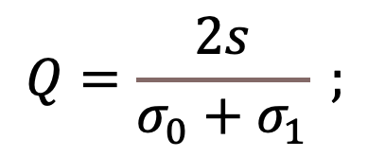
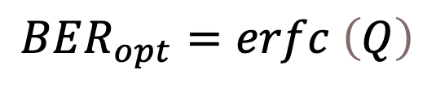
Defining Q: systems with amplifiers
Signal dependent noise requires a definition of Q which accommodates optimum threshold <0.5
Peak signal level is 2s
Threshold is optimally placed at σ₀/(σ₀+σ₁)
$$Q=\frac{2s}{σ_{0}+σ_{1}} ;$$
$$BER_{opt}=erfc \left(Q\right)$$
Notes:
Voltages at the decision instants are Gaussian random variables with means V₀ and V₁, and variances σ₀² and σ₁²

Slide 33
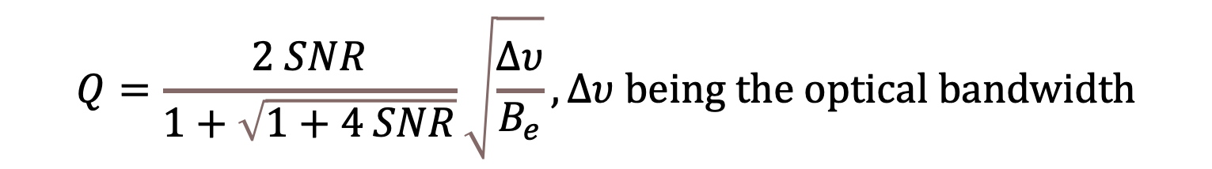
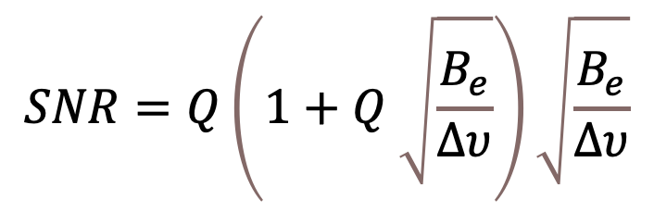
Q and SNR
It is convenient to define a signal to noise ratio in terms of the mean number of signal photons per second, s, and the mean spontaneous noise in photons per second at any point in a system: SNR(dB)=10log(s/n)
Note that optical dB calls for a factor of 10 multiplier while electrical Q uses a factor of 20
In the beat noise limit SNR and Q are related by:
$$Q=\frac{2 SNR}{1+\sqrt{1+4 SNR}}\sqrt{\frac{Δυ}{B_{e}}}, Δυ being the optical bandwidth$$
$$SNR=Q\left(1+Q \sqrt{\frac{B_{e}}{∆υ}}\right)\sqrt{\frac{B_{e}}{∆υ}}$$

Slide 34
Types of Coding
Source Coding
Method of encoding the raw data
Error Detection Coding
Detection of errors in the data sequence
Error Correction Coding
Detection and Correction of Errors
Line Coding
Formatting of the transmitted data stream to benefit transmission

Slide 35
Source Coding
We have seen already how the digitised voice is encoded against a code word for each level.
ASCII is a common source coding scheme for transmitting text.
! 0100001
/ 0101111
0 0110000
9 0111001
: 0111010
@ 1000000
A 1000001
Z 1011010
a 1100001
z 1111010
~ 1111110

Slide 36
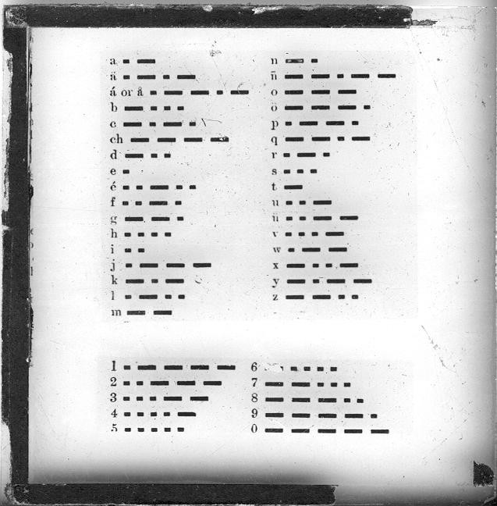
Source Coding is not new

Slide 37
Error Detection/Correction
We require a reliable channel, i.e. BER > x
What can we do if this is not possible?
Increase the power
Diversity in space/frequency or time
Full Duplex (echo information)
Automatic repeat Request (ARQ)
Forward Error Correction
All of these introduce a certain amount of redundancy

Slide 38
prediction/error correction is also not new…
cdnuolt blveiee taht I cluod aulaclty uesdnatnrd waht I was rdgnieg THE PAOMNNEHAL PWEOR OF THE HMUAN MNID Aoccdrnig to a rscheearch at Cmabrigde Uinervtisy, it deosn't mttaer in waht oredr the ltteers in a wrod are, the olny iprmoatnt tihng is taht the frist and lsat ltteer be in the rghit pclae. The rset can be a taotl mses and you can sitll raed it wouthit porbelm. Tihs is bcuseae the huamn mnid deos not raed ervey lteter by istlef, but the wrod as a wlohe. Amzanig huh?

Slide 39
ARQ
Three common ARQ techniques exist
Stop-and-wait: The sender(Tx) sends a frame and then waits for acknowledgement for the receiver (Rx).
Go-back-n: Sender sends frames in a sequence with acknowledgement from Rx. On error Rx discards current and further frames and notifies Tx of frame required. Tx starts again from this point
Selective repeat: Tx only repeats those frames for which negative acknowledgements are received.
Notes:
Stop and Wait – Slow and is suited to half duplex systems
Go back n – Must be an arrange response channel on half duplex systems, on duplex links the sender must not send any more frames than there are numbers to identify them, before receiving acknowledgement.
Selective Repeat – Problem that frames may arrive out of sequence. For low error rates this is only marginally better that go back n.

Slide 40
Line Coding
We have considered so far only unipolar pulses to represent the binary bits in our system
However, other pulse types can be used to represent these bits
This is line coding, use for one or more of the following reasons
Presence or absence of a DC level
To shape the power spectral density
Bandwidth
Noise immunity
Ease of clock recovery

Slide 41
Example Line Codes
+V
+V
Unipolar
NRZ
polar
NRZ
0
0
T₀
T₀
-V
-V
+V
+V
Unipolar
RZ
polar
RZ
0
0
-V
-V
+V
+V
Dipolar
OOK
Dipolar
Antipodal
/Manchester
0
0
-V
-V

Slide 42
Line Code Spectrum
Unipolar NRZ
V²T₀/4
Polar NRZ
V²T₀
B=0.44/T₀
-2/T₀
-1/T₀
1/T₀
2/T₀

Slide 43
Line Code Spectrum
Unipolar RZ
V²T₀/16
Polar RZ
V²T₀/4
B=0.88/T₀
-2/T₀
-1/T₀
1/T₀
2/T₀

Slide 44
Line Code Spectrum
Dipolar OOK
V²T₀/8
Dipolar Antipodal /Manchester
V²T₀/2
B=1.16/T₀
-2/T₀
-1/T₀
1/T₀
2/T₀

Slide 45
Example Line Codes
Coding Type | Comment
Unipolar NRZ | Usual format, DC term
Unipolar RZ | Simple timing extraction, DC term
Polar NRZ | Constant envelope, DC term
Polar RZ | Timing extraction by rectifying, DC term
Dipolar OOK | Simple timing extraction, no DC term
Manchester | Zero DC and Constant envelope
CMI | Simple timing extraction, no DC term
nBmT | Timing extraction by rectifying, no DC term

Slide 46
8B10B
Maps 8-bit symbols to 10-bit symbols
The low 5 bit of data are encoded into a 6-bit group (the 5b/6b portion)
The top 3 bits are encoded into a 4-bit group (the 3b/4b portion).
DC-balance
Difference between number of1s and 0s in a string of at least 20 bits is no more than 2
enough state changes to allow clock recovery
run-length limit of 5 consecutive equal bits
Firewire, SerialATA, HDMI, USB3.0, some GE

Slide 47
Multi-level signalling
For the same data rate the symbol rate (Baud rate) is reduced, which implies less noise at the output of the receiver filter
For the same average transmit power the amplitude discrimination between adjacent signal levels is reduced, which implies reduced tolerance against noise
Overall the BER/power performance is worse for m-ary than for binary - but the reduced bandwidth requirements may justify it use

Slide 48
m-ary baseband signalling
Increasing the number of levels for the same symbol rate provides for increased data rate over a given bandwidth channel
With the same average power this implies a reduction in margin against noise - or to maintain the noise margin and hence BER there must be an appropriate increase in received power.
Alternatively, for a given information rate requirement increasing the number of levels can allow the symbol rate (Baud rate) to be reduced - which reduces the bandwidth and hence the noise - and so tends to ameliorate the increase compared with the binary case

Slide 49
Modulation
Amplitude Modulation
Envelope AM
Double sideband suppressed carrier modulation, DSB-SC
Quadrature amplitude modulation (QAM)
Angle Modulation
Frequency modulation (FM)
Phase Modulation (PM)
Combined amplitude and phase modulation

Slide 50
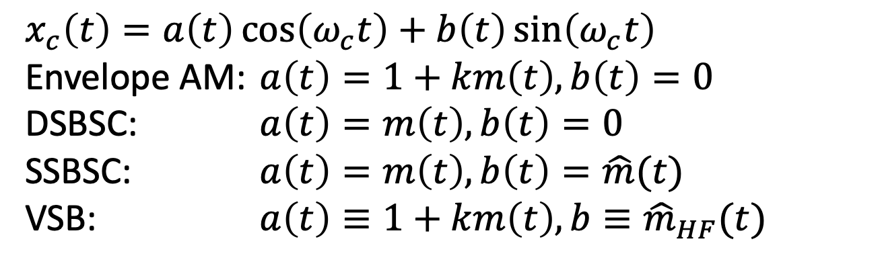
AM schemes - analytic form
$x_{c}\left(t\right)=a\left(t\right)\cos\left(ω_{c}t\right)+b\left(t\right)\sin\left(ω_{c}t\right)$
Envelope AM: $a\left(t\right)=1+km\left(t\right), b\left(t\right)=0$
DSBSC: $a\left(t\right)=m\left(t\right), b\left(t\right)=0$
SSBSC: $a\left(t\right)=m\left(t\right), b\left(t\right)=\hat{m}(t)$
VSB: $a\left(t\right)≡1+km\left(t\right), b≡{\hat{m}}_{HF}(t)$
Message bandwidth W
Envelope AM, DSBSC and QAM require bandwidth of 2W
SSBSC requires bandwidth of W
VSB requires W<bandwidth<2W
SSB and QAM are power and bandwidth efficient

Slide 51
How to choose a digital modulation scheme
Power efficiency (E_{b}/N_{o} for a given BER)
Bandwidth efficiency (bits/s/Hz)
Performance in the presence of non-idealities (fading, noise, distortion, jitter, non-linearity)
Cost and complexity
Not all of these can be satisfied simultaneously!!

Slide 52
Angle Modulation
Frequency and phase modulation are closely related - frequency corresponds to rate of change of phase
FM requires a bandwidth of W=2Fm(1+β ) - Carson’s rule - β is the modulation index or peak deviation ratio
FM and PM are tolerant to amplitude nonlinearity and so are compatible with high power amplifiers.
FM offers an ‘improvement factor’ compared with AM of the order of 3β ²
FM systems have noise proportional to f²; pre-emphasis is employed to allow for this

Slide 53
ASK schemes 1:
Baseband signal
Modulated waveform
carrier, fc
The carrier is switched on and off by the unipolar binary signal, hence this form of ASK is sometimes referred to as on-off keying (OOK)
In terms of analogue AM this is equivalent to binary envelope modulation with 100% modulation depth

Slide 54
ASK Schemes 2:
Baseband signal
Modulated waveform
t
carrier, fc
Note phase ‘switch’
Note that this arrangement is equivalent to binary phase shift keying (BPSK) with 0 and π as the two phases
In terms of analogue AM it is the equivalent of DSB-SC
With an m-ary baseband input the modulated signal is multi-level ASK (m-ary ASK)

Slide 55
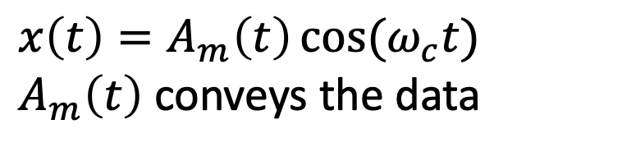
Amplitude Modulation
$x\left(t\right)=A_{m}\left(t\right)\cos{(ω_{c}t)}$
$A_{m}\left(t\right)$ conveys the data
Can carry n-bits/symbol with 2^{n} amplitudes
Envelope varies with the data - sensitive to amplitude distortion

Slide 56
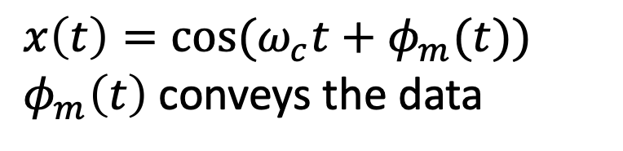
Phase Modulation
$x\left(t\right)=\cos{(ω_{c}t+φ_{m}(t))}$
$φ_{m}\left(t\right)$ conveys the data
Can carry n-bits/symbol with 2^{n} phases
Constant envelope provides tolerance to amplitude distortion

Slide 57
Phase-shift keying
010
011
001
100
000
101
111
110
Possible signal phases for 8-phase PSK
With 8=2³ phases there are 3 bits per symbol
The phase coding shown is illustrative - not necessarily the best choice!

Slide 58
Phase-shift keying – Grey Code
011
010
001
110
000
111
100
101
Grey Coding means that there will only be one bit in error if a decision is made in the wrong sector
This form of coding is used with most angle modulation schemes

Slide 59
Frequency shift keying
t
1
0
0
1
Binary FSK involves gating between two oscillators of different frequencies - with an obvious extension to m-ary FSK
An alternative is to apply the baseband signal to drive a voltage controlled oscillator, which avoids phase discontinuities
Again, the m-ary extension is straightforward

Slide 60
QAM Signals
Signal space diagram or constellation
16 state QAM signal
4 bits per symbol
Amplitude depends on state (data) being conveyed

Slide 61
Quadrature amplitude modulation (QAM)
Q
I
16-ary QAM has 4 in-phase and 4 quadrature signal levels, giving a total of 16 possible points in the signal constellation
The capacity of this arrangement is 4 bits per symbol - 2 each for the in-phase and quadrature components
The above is only ONE example. There are many others…

Slide 62
QAM signal generation
X
Quadrature m-ary ASK component
Baseband signal, even bits
Digital QAM modulated signal
sine carrier
Σ
cosine carrier
Baseband signal, odd bits
X
In-phase m-ary ASK component

Slide 63
Phase Shift Keying
From analogue modulation we know that DSB-SC provides the same SNR as does baseband transmission
Hence 2 φ PSK (which corresponds to polar binary ASK) similarly provides the same SNR - and hence BER - as baseband binary transmission
4-f PSK(equivalent to 4 state QAM) similarly achieves the same performance as baseband transmission for the same data rate - or equivalently allows a factor of 2 increase in data rate over a given bandwidth channel at the expense of only a factor of 2 (3dB) increase in required received power
m-ary PSK provides further increase in data rate for a given channel bandwidth at the expense of increased received power requirements for a given BER

Slide 64
Unfiltered PSK Power Spectra
0
2-PSK
PSD
(dB)
-10
4-PSK
-20
8-PSK
-30
1/3T
1/2T
1/T
Based on uncorrelated data and rectangular NRZ signalling

Slide 65
MSK - minimum shift keying
A form of binary FSK (Continuous Phase FSK)
Frequencies are such that exactly π/2 phase shift exists between the two signals in one symbol interval. This is achieved by fixing the frequency separation between carriers to be equal to the symbol rate (or its integer multiples)
MSK produces the maximum phase difference using the minimum difference in signalling frequencies
For MSK Δω=π/Τ and m₂(t) is a symmetric binary NRZ signal
The result is bandwidth limitation
And there is Gaussian MSK (GMSK) used in GSM systems

Slide 66
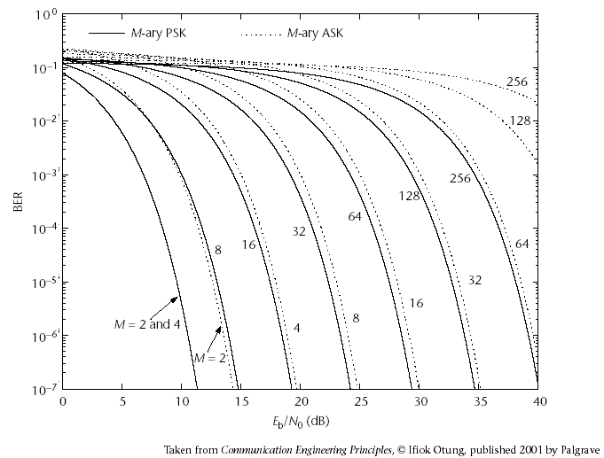
Performance

Slide 67
Summary
Binary signalling
Eye diagrams
ISI and jitter considerations
Noise and system performance
Modulation and multi-level signalling

